Slide 1
Iot Slides

Slide 2
What is IoT
The internet of things(IoT) is a network of interconnected computing devices, mechanical and digital machinery, objects, animals, and people with unique identifiers (UIDs) and the ability to transfer data without requiring human-to-human or human-to-computer interaction.
The internet of things helps people live and work smarter, as well as gain complete control over their lives. IoT provides businesses with a real-time look into how their systems really work, delivering insights into everything from the performance of machines to supply chain and logistics operations.

Slide 3

History of IoT
The Internet of Things, as a concept, wasn’t officially named until 1999 by Kevin Ashton.
Kevin Ashton, the Executive Director of Auto-ID Labs at MIT, was the first to describe the Internet of Things, while making a presentation for Procter & Gamble.

Slide 4
History of IoT(Cont.)
One of the first examples of an Internet of Things is from the early 1980s, and was a Coca Cola machine, located at the Carnegie Melon University. Local programmers would connect by Internet to the refrigerated appliance, and check to see if there was a drink available, and if it was cold, before making the trip.
The term Internet of Things reached mass market awareness when in January 2014 Google announced to buy Nest for $3.2bn. At the same time the Consumer Electronics Show (CES) in Las Vegas was held under the theme of IoT.

Slide 5
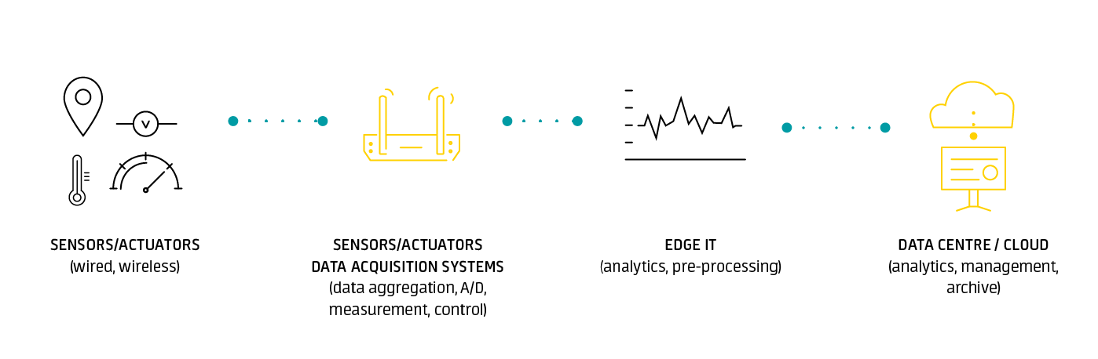
IoT Architecture
IoT system architecture is often described as a four-stage process in which data flows from sensors attached to “things” through a network and eventually on to a corporate data center or the cloud for processing, analysis and storage.

Slide 6
IoT Architecture(Cont.)
STAGE 1: Sensors and Actuators
The process starts with sensors and actuators, the connected devices that monitor (in the case of sensors) or control (in the case of actuators) some “thing” or physical process. Sensors capture data regarding the status of a process or an environmental condition
STAGE 2: Internet Gateways and Data Acquisition Systems
A data acquisition system (DAS) collects raw data from the sensors and converts it from analog into digital format. The DAS then aggregates and formats the data before sending it through an Internet gateway via wireless WANs (such as Wi-Fi or Cellular) or wired WANs for the next stage of processing.

Slide 7
IoT Architecture(Cont.)
STAGE 3: Pre-processing: Analytics at the Edge
The edge device may perform some analytics as part of the pre-processing. Machine learning can be very helpful at this stage to provide feedback into the system and improve the process on an ongoing basis. Processing of this type will generally take place on a device in a location close to where the sensors reside, such as in an on-site wiring closet.
STAGE 4: In-depth Analysis in the Cloud or Data Center
powerful IT systems can be brought to bear to analyze, manage, and securely store the data. This usually takes place in the corporate data center or in the cloud, where data from multiple field sites/sensors can be combined to provide a broader picture of the overall IoT system and deliver actionable insights to both IT and business managers.

Slide 8
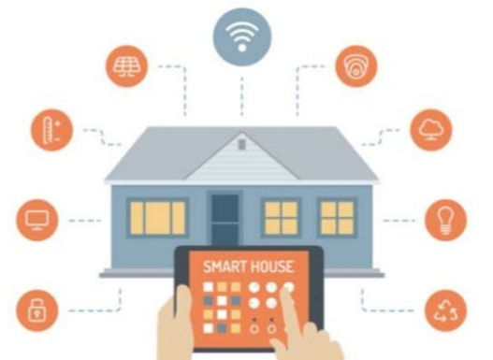
IoT Use Cases
Building and Home Automation
Evironment monitoring

Slide 9

IoT Use Cases(Cont.)
Medical and Healtcare systems
Smart Transportation

Slide 10
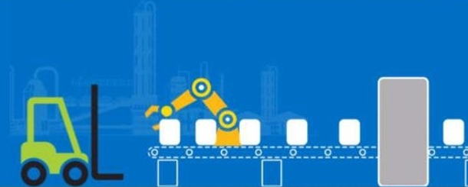

Smart Manufacturing
Energy resource management

Slide 11
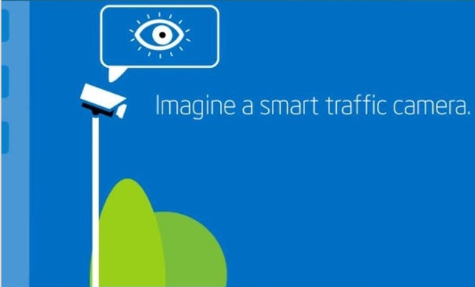
Example
The camera can monitor the road for congestion, accident and weather conditions an communicate that data to a gateway that combines it with data from other such cameras creating an intelligent city-wide traffic system.

Slide 12
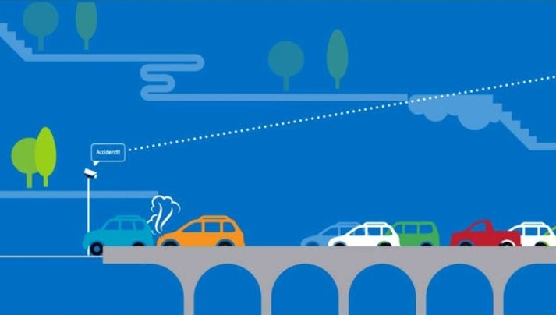
Example(Cont.)
Lets say the city's intelligent traffic system detects massive congestion due to an accident.

Slide 13
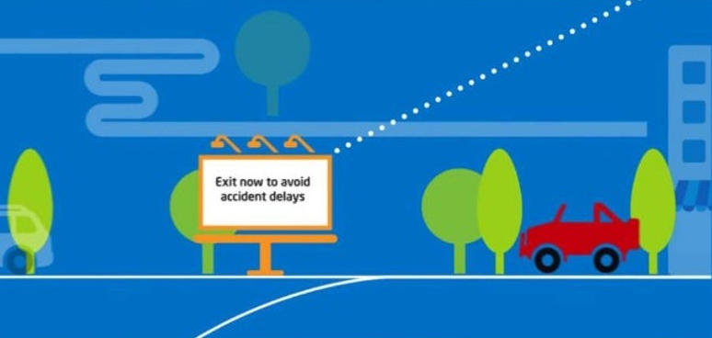
Example(Cont.)
That insight can be sent to the city-wide transportation system which can analyze an derive optimum routes around the accident and send those instructions to city's digital signed systems to guide drivers around the accident.

Slide 14
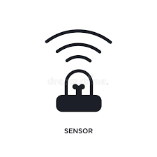


IoT Challenges
Sensing in a complex environment
Little innovative ways to sense and deliver information from physical world to the cloud.
Connectivity
Variety of wired and wireless standards are required to enable different application needs.
Power
Many IoT applications need to run for years over battery and reduce the overall energy consumption.

Slide 15

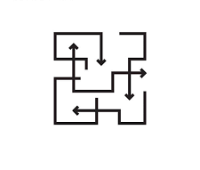

IoT Challenges(Cont.)
Security
Protecting user's privacy, manufacturer's IP and blocking malicious activity.
Complexity
IoT application development need to be easy for all developers not just experts.
Cloud
IoT applications require end-to-end solutions including cloud services.

Slide 16
Future trends in IoT
IoT Cybersecurity Concerns Grow
As more people gain access to IoT devices and the attack surface grows, IoT companies themselves will need to take responsibility for cybersecurity efforts upfront.
IoT Advancements In Health Care
IoT solutions are assisting health care professionals with more direct care in situations where they cannot provide affordable or safe hands-on care.

Slide 17
Future trends in IoT(Cont.)
5G Enables More IoT Opportunities
Hyperconnectivity and ultra-low latency are necessary to power successful IoT solutions. 5G is the connectivity that will make more widespread IoT access possible.
Demand For Specialized IoT Data Management
Storing this data is the first hurdle. Making it all sync together seamlessly is the challenge that organizations face next year as IoT deployments continue to scale at a rapid pace.

Slide 18
Future trends in IoT(Cont.)
Bundled IoT For The Enterprise Buyer
The next big wave of IoT adoption will be in bundled IoT or off-the-shelf IoT solutions that offer user-friendly operational functions and embedded analytics.
IoT data analysis will inevitably lead to AI
Traditional analysis will fade away and organizations will increasingly use AI.

Slide 19
Conclusion
As the price of sensors and communications continue to drop, it becomes cost-effective to add more devices to the IoT.
Deployments are at an early stage; most companies that are engaging with the IoT are at the trial stage right now, largely because the necessary technology are still themselves at a reasonably early stage of development.
Without standards, and with security an ongoing issue, we are likely to see some more big IoT security mishaps in the next few years.

